Slide 1

Transportation Cost Optimization
Jiawei Wang
Kunpeng Hao
Ziyue Liu
Professor Raiarathnam Chandramouli

Slide 2



Content
Abstract
Tasking
The Method of Optimization
Milestone
Prospect

Slide 3
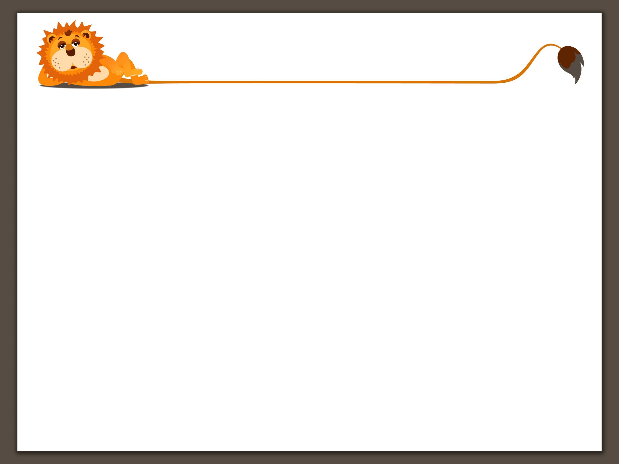
Division
1. Jiawei Wang: Data analysis, collecting data,
prepare PPT for presentation
2. Kunpeng Hao: Building mathematical model,
Data analysis
3. Ziyue Liu: Collecting data, analysis of data,
prepare PPT for presentation

Slide 4
Abstract
With the acceleration of urbanization, China‘s air transport industry has witnessed rapid growth. According to Analysis Report on Development of Civil Aviation Transportation in China(2017-2018), freight demand increased by 9.3% in 2017.
But China still don’t have a exclusive cargo airport. To improve freight efficiency and capacity, SF Express(ShunFeng) decided to build a cargo airport in WuHan Province(N30.3247, E115.0592) with 2450000 tons/year design handling capacity in 2020.
Our ultimate goal is optimize the airport's best location in the absence of policy and topography.

Slide 5
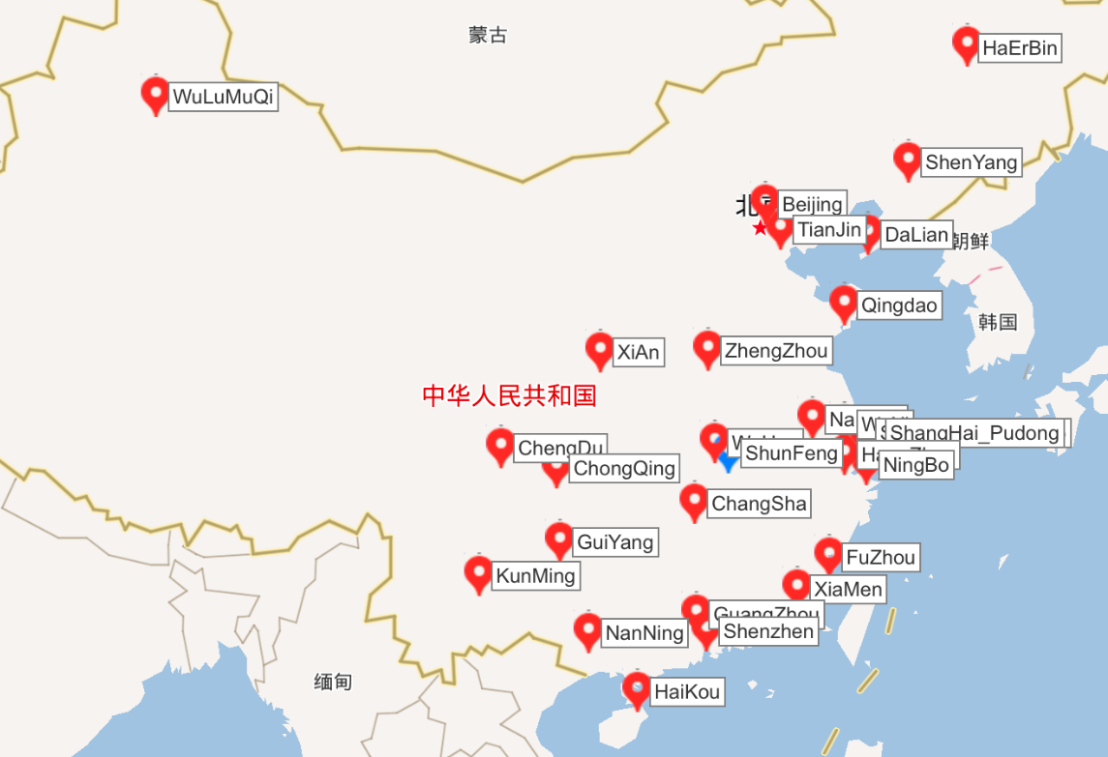
Data
We choose whole 27 airports which handling capacity are more than 1000000 tons/year(red point) and SF Express(ShunFeng) coordinate airport(blue point). Location are shown by latitude and longitude.
Data from 2017 China Civil Aviation Airport Production Statistics Bulletin.

Slide 6
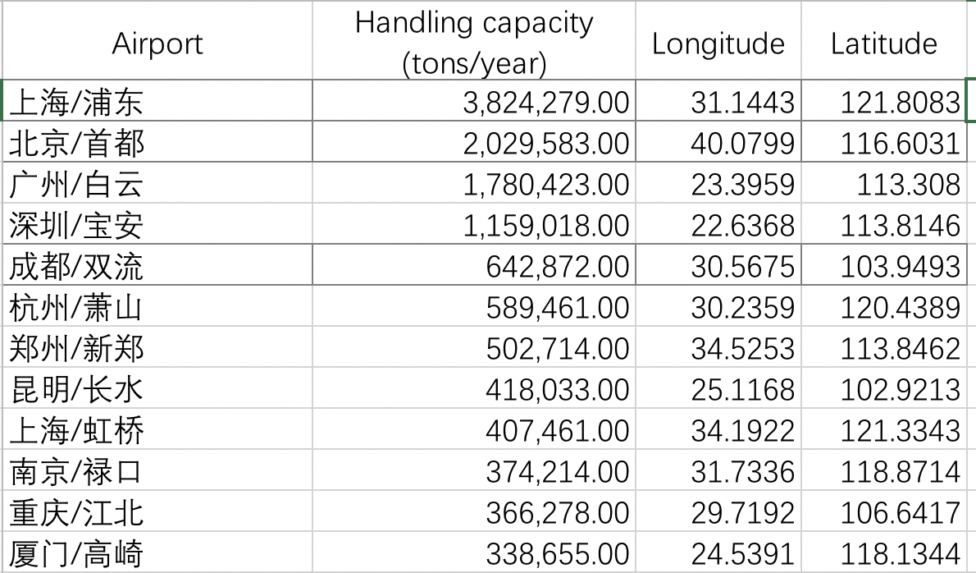
Data
Part of Data we collected

Slide 7
Tools We Use
Matlab
Optimization Tool Box
Constrained Nonlinear Optimization. (fmincon)
Great-circle distance formula. (distance)
S=R·arc cos[cosβ1cosβ2cos（α1-α2）+sinβ1sinβ2]

Slide 8

Research 1
According to the 27 known airports handling capacity, find the best supply point position to minimize the cost.(tons * km)
Optimal point is the only supply point, all others airports are receive points.

Slide 9
Research 1
Min:
Transport capacity * Distance
s.t:
1. In receive point, receiving quantity equal to demands.
(linear equality)
2. Optimal point position belongs to Mainland China. (lb, ub)
Part of Receive Point Data we choose

Slide 10
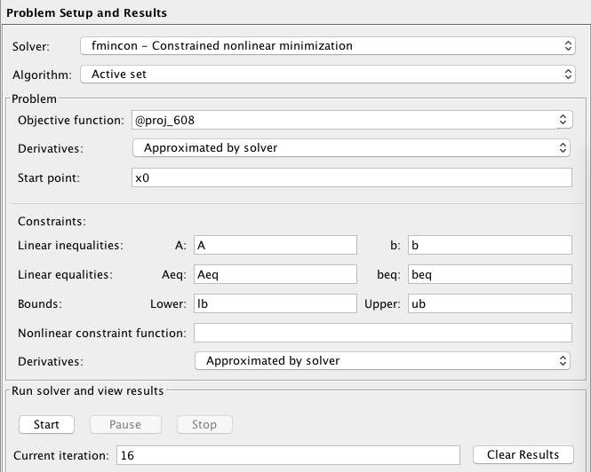
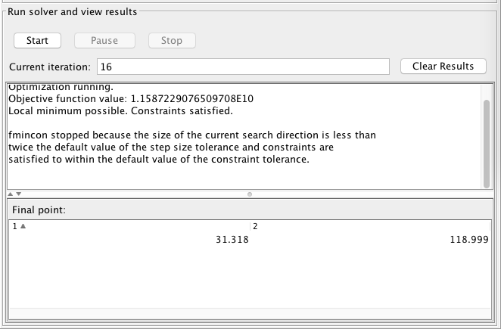
Research 1
Result in Matlab Optimization Tool Box

Slide 11
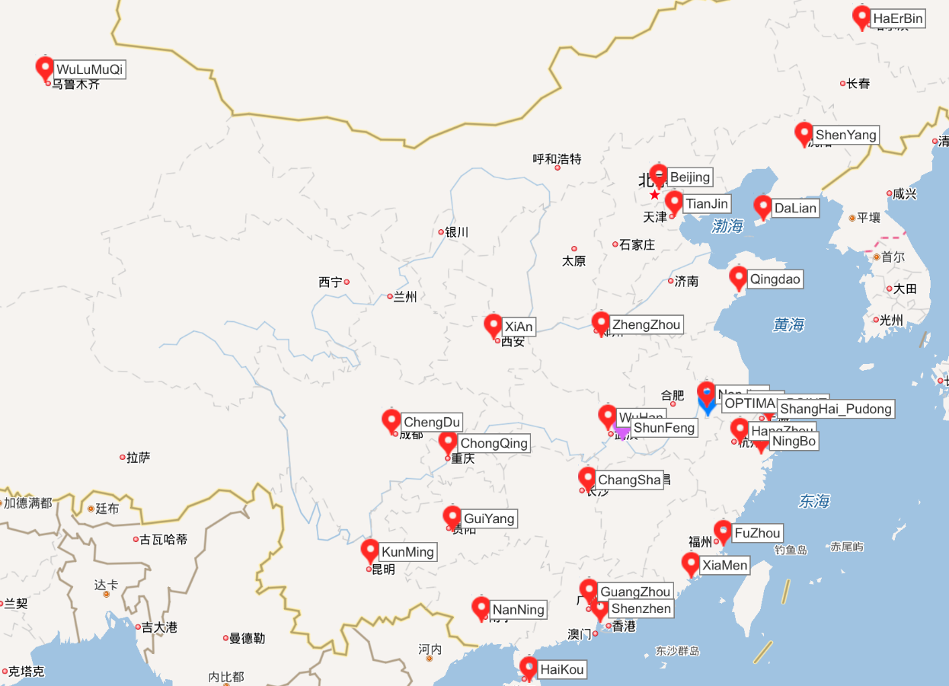
Research 1
Min:
Transport capacity * Distance
Position of Optimal Point:
(31.318 118.999)
Value of Optimal Point(blue):
1.16 * 10^10 tons*km
Value of Shunfeng point(pink):
1.24 * 10^10 tons*km
Optimal Point and Conclusion

Slide 12

Research 2
1. Demand exceeds Supply
2. Supply exceeds Demand

Slide 13
Research 2
In Research 2, we consider two different conditions: how to design the optimal location when demand exceeds supply or supply exceeds demand.
Demand exceeds Supply: Base on some reality(Big international airport, Deep water port, Regional center, etc.), we choose 3 airports as supply points and others as demand points, but demands capacity are more than supplements. So optimal point will be treat as a supply point in this part.
Supply exceeds Demand: Base on some reality(Big international airport, Deep water port, Regional center, etc.), we choose 6 airports as supply points and others as demand points, but supply capacity are more than demands. So optimal point will be treat as a demand point to store excess cargo in this part.

Slide 14
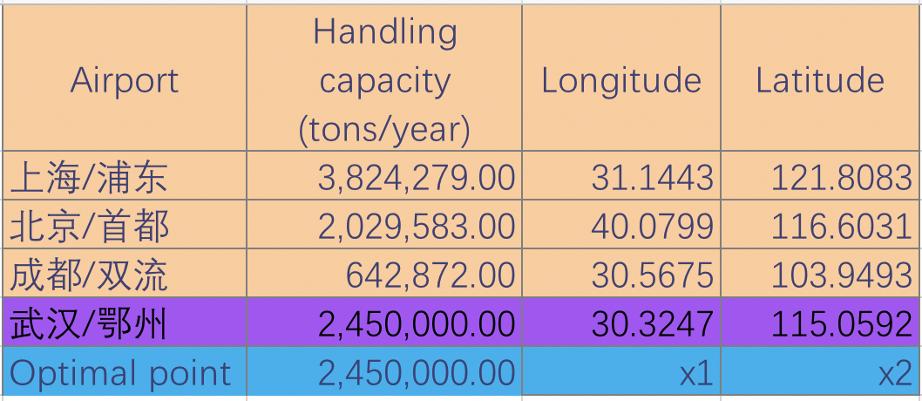
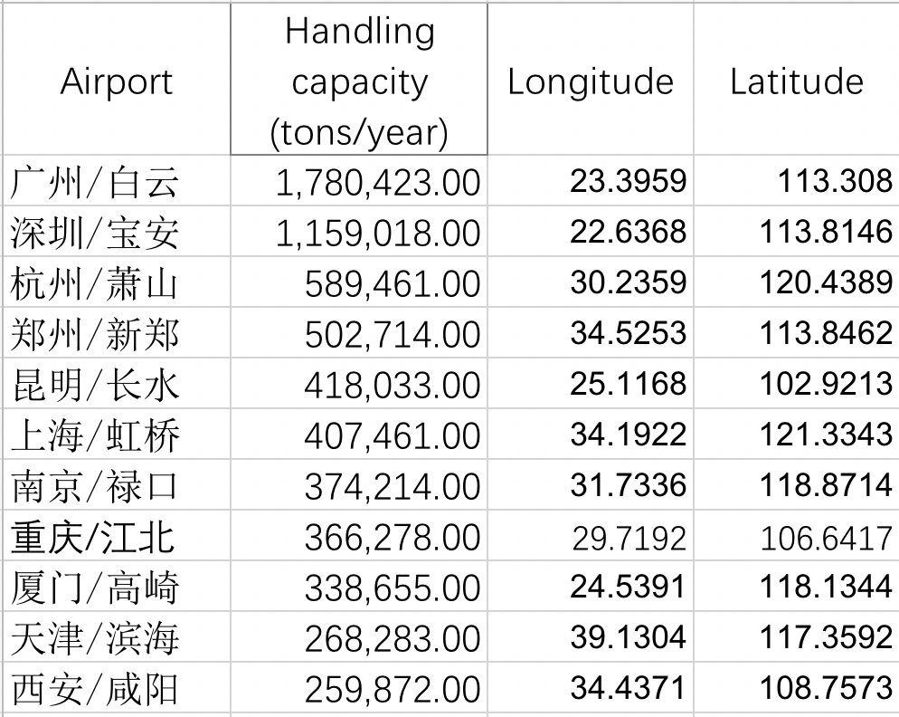
2.1 Demand exceeds Supply
Min:
Transport capacity * Distance
s.t:
1. In receive point, receiving quantity equal to demands. (linear equality)
2. The supply point output is less than the actual cargo capacity of each airport. (linear inequality)
3. According to the actual situation, limit some supply volume.
(linear inequality)
4. Optimal point position belongs to Mainland China. (lb, ub)
Receive Point Data we choose
Part of Supply Point Data we choose

Slide 15
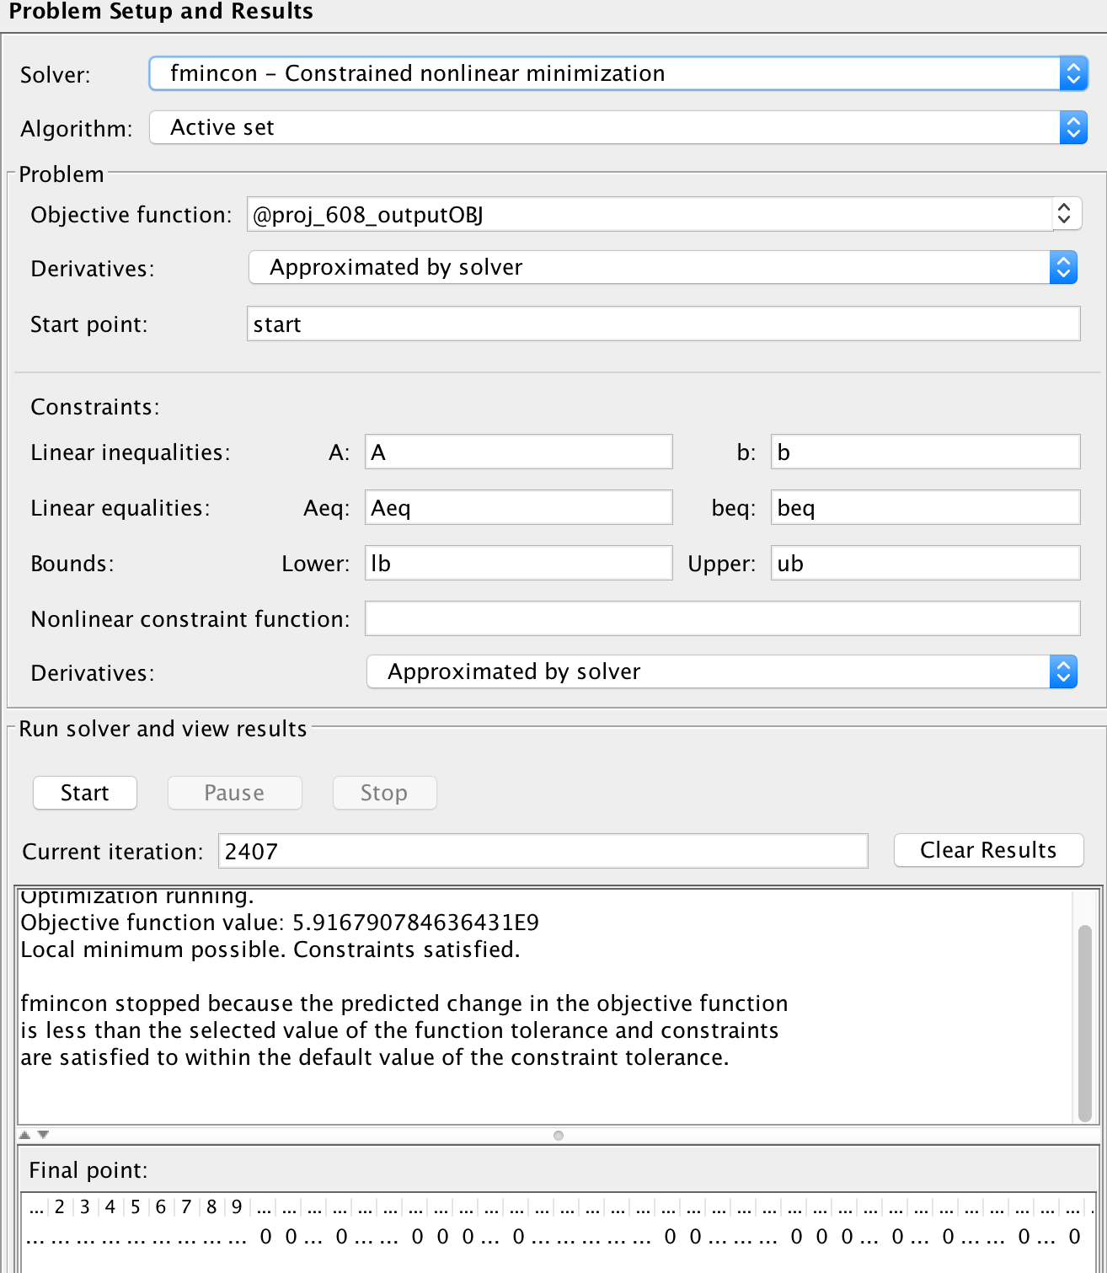
2.1 Demand exceeds Supply
Result in Matlab Optimization Tool Box

Slide 16
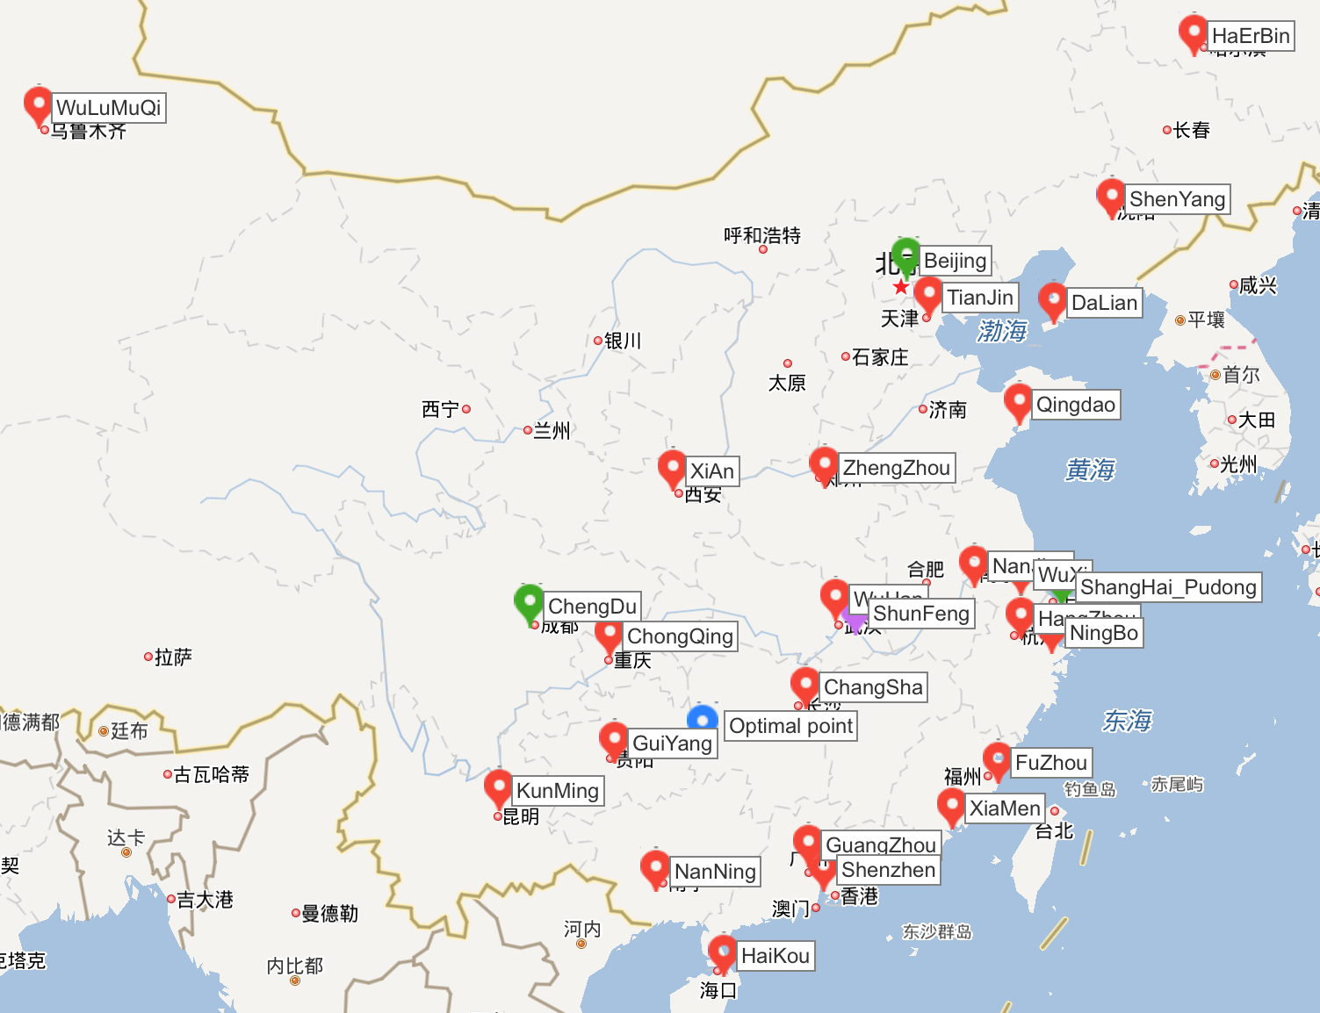
2.1 Demand exceeds Supply
Min:
Transport capacity * Distance
Position of Optimal Point:
(27.0480, 109.3080)
Value of Optimal Point:
5.91 * 10^9 tons*km
Value of Shunfeng point:
6.87 * 10^9 tons*km
Optimal Point and Conclusion

Slide 17
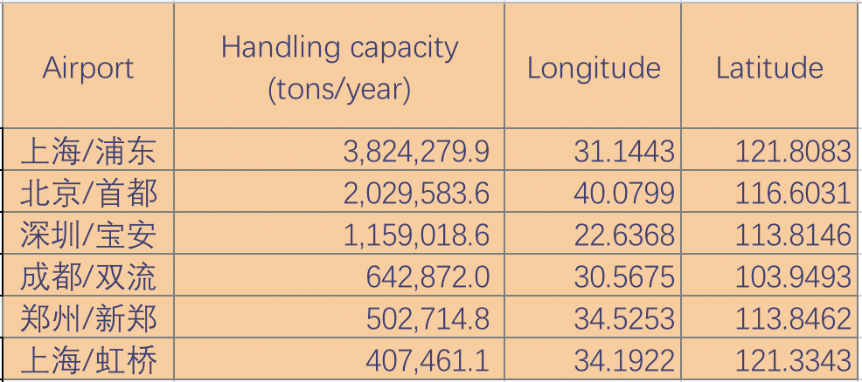
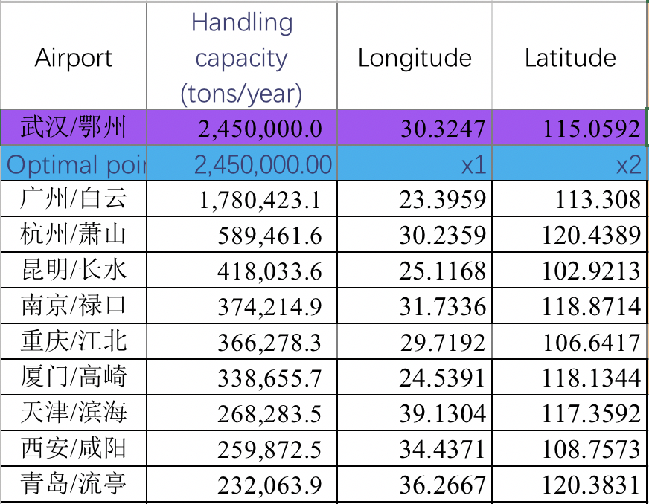
2.2 Supply exceeds Demand
Min:
Transport capacity * Distance
s.t:
1. In receive point, receiving quantity less than demands. (linear inequality)
2. The supply point output is equal to actual cargo capacity of each airport.
(linear equality)
3. According to the actual situation, limit some supply volume. (linear inequality)
4. Optimal point position belongs to Mainland China. (lb, ub)
5. The distance between supply point and optimal point less than 150km.
(nonlinear constraints)
Receive Point Data we choose
Part of Input Point Data we choose

Slide 18
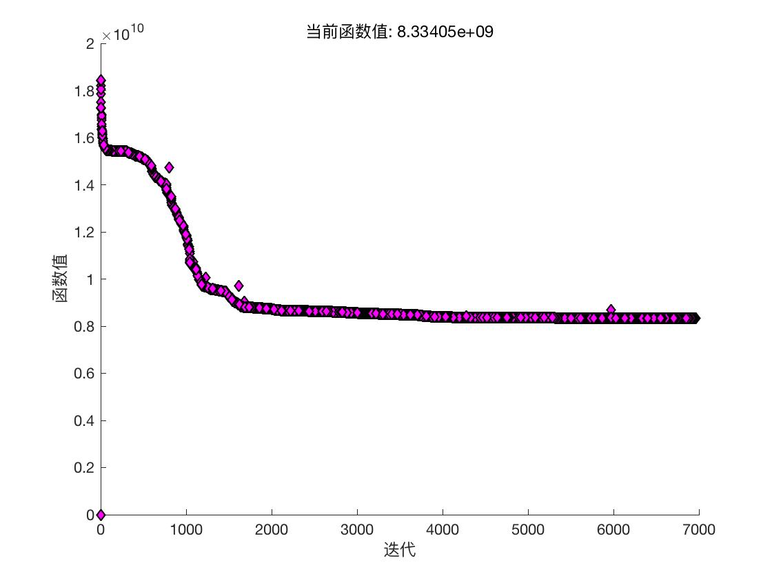
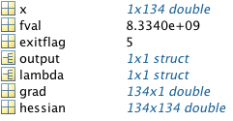
2.2 Supply exceeds Demand
Result in Matlab Optimization Tool Box

Slide 19
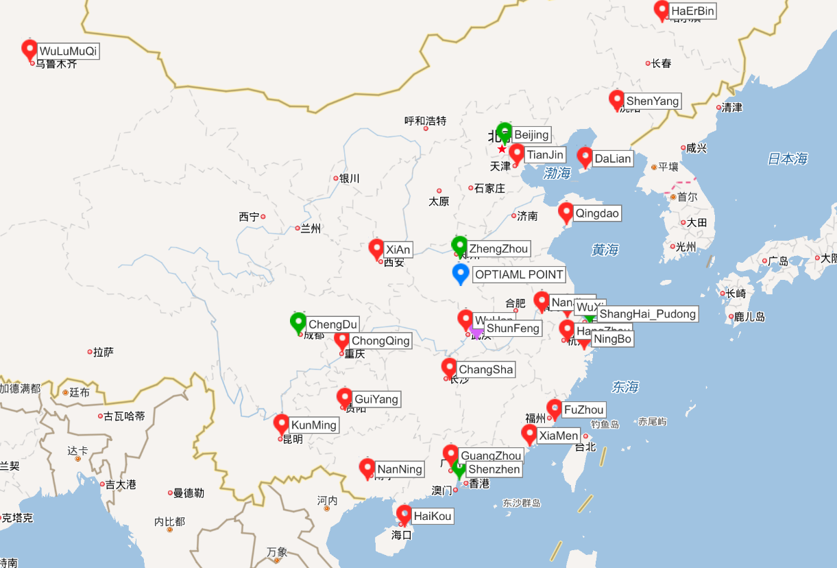
2.2 Supply exceeds Demand
Min:
Transport capacity * Distance
Position of Optimal Point:
(33.1763, 113.8492)
Value of Optimal Point:
8.33 * 10^9 tons*km
Value of Shunfeng point:
9.17 * 10^9 tons*km
Optimal Point and Conclusion

Slide 20
Milestone
6th April: Data collecting
13th April: Build a mathematical model
17th April: Mathematical model perfection
25th April: Dealing with data and ensure which model are suppsed to take.
27th April: Prepare for presentation

Slide 21
Prospect
In our project, each airport only has one task, supply or demand.
But in reality, each airport has its own needs and supplies. It’s hard to show in our project because it increases the difficulty of modeling and requirements for data collection. We still hope we can build a new mathematical model for this conditions after get enough data and has more skills.

Slide 22

Thank you !

